Slide 1
Multimodal Anomaly Detection
Yue Zhao*, Xiyang Hu*, Wen Wang*
Midterm Report
*Equal contribution
Notes:
Main title: 40 pt. Arial
Presenter Name: 16 pt. Arial
Presenters Title: 16 pt. Arial Italic

Slide 2
Anomaly Detection & Challenges
Anomaly detection, also known as outlier detection, aims to identify the data samples that are deviant from the general distribution. This task is deemed unsupervised.
For long, it only concerns unimodal setting, although it is natural to consider for multimodal setting.
There might be multiple sensors on an autonomous driving car, and a security issue or emergency may be identified through anomaly detection (modeled as rare events) via all kinds of sensors.
By analyzing medical image and clinical note, we may identify rare disease (as anomaly) more effectively.
In this work, we plan to explore the possibility of leveraging multimodal machine learning in anomaly detection. To our best knowledge, there is no immediate multimodal works for anomaly detection. There are a few relevant works but not directly concern this problem.

Slide 3
Research Questions
How to generate and extract multimodal data representation for anomaly detection? For example, autoencoder is a natural choice for this purpose, and we may directly extract the latent space and conduct anomaly detection on the latent space.
Will multiple modalities help the identification of anomalies? We may compare multimodal setting to unimodal setting, and ensemble learning with multiple unimodalities, to understand which approach leads to better detection quality.
Can we make anomaly detection part of the multimodal learning process and have an end-to-end learning method?
To foster reproducibility and further research on this new problem, we open-source our entire multimodal system, benchmark environment, and testbed datasets.

Slide 4
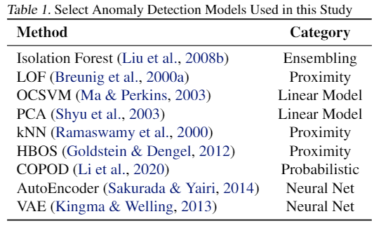
Experiment Setup
First generate multiple representations falling in the unimodal and multimodal categories
Three unimodal representations
Four multimodal representations
Conduct anomaly detection with multiple popular algorithms on these representations
Evaluate the generated outlier scores by various key metrics:
ROC AUC (ROC), Precision @ n (P@N), and Average Precision (AP)

Slide 5
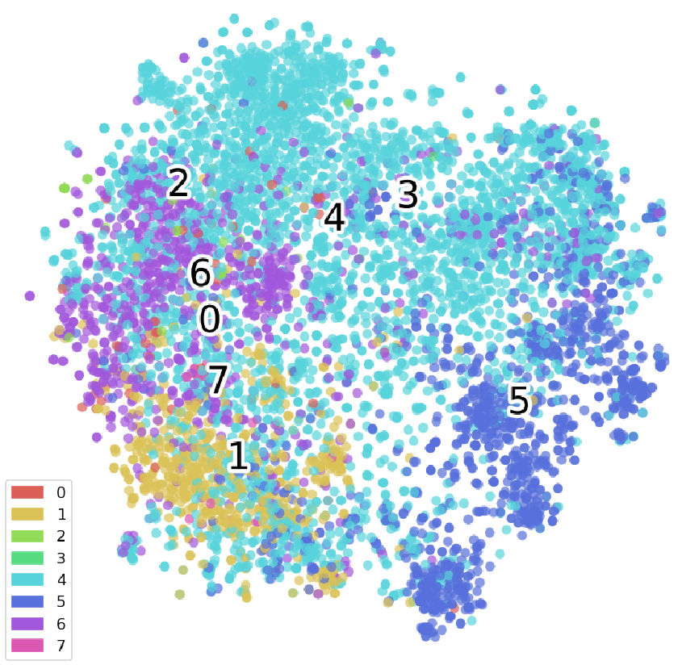
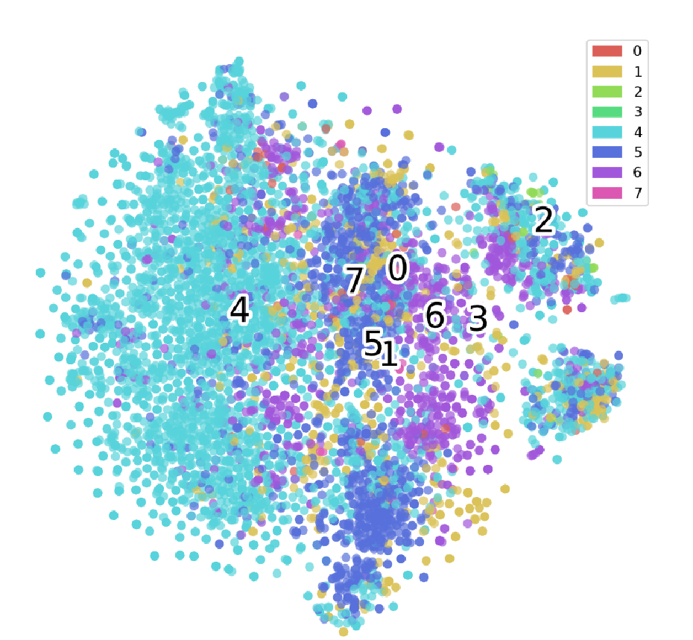
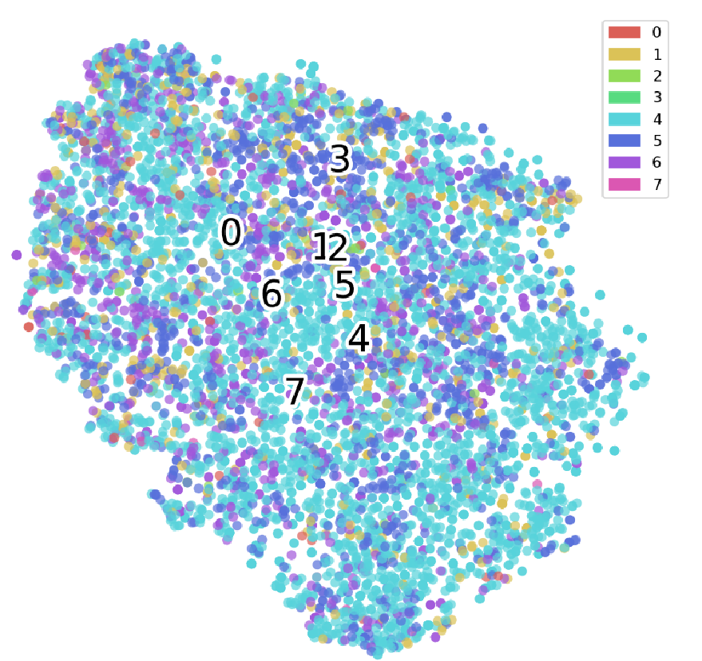
Unimodal Representations
We first analyze the unimodal representation with pretrained models. From left to right, we show the t-SNE visualization of Unimodal_Image (ResNet-18, 512 dimensions), Unimodal_word2vec (word2vec, google-news, 300 dimensions), and Unimodal_Bert (sentence level, Bert, 768 dimensions).
Image
Word level
Sentence level

Slide 6
Multimodal Representations
Multimodel_Score_Combination: Using unimodal representation for anomaly detection, and then average the outlier scores from image and text modality.
Multimodel_Input_Concat: directly concatenate the raw image and text representation. This baseline does not learn any joint relationship between image and text.
Multimodal_Embedding_Concat: train two single-direction MLPs:
the input is image representation and output is text representation.
The input is text representation and output is image representation.
We take the last hidden layer from two models and concatenate them together to have two-way relation between image and text.
Multimodel_Joint_Embedding: a VAE which takes the concatenated raw image and text representation as input, and goal is to reconstruct the input. We use the latent representation as the embedding for downstream anomaly detection.

Slide 7
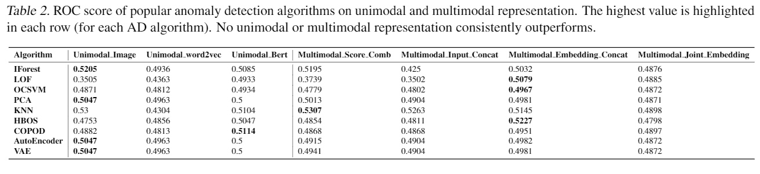
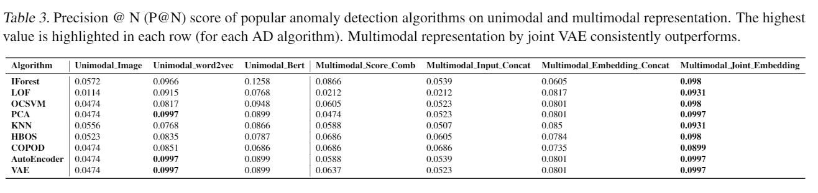
Performance & Discussion
Simply combining the anomaly scores generated from unimodal representations does NOT work
Multimodal representations outperform regarding P@N and AP, showing the effectiveness of taking all modalities into account
Among four multimodel baselines, multimodal joint embedding that learns a joint representation by concatenate the input of image and word2vec shows the best result

Slide 8
Performance & Discussion
Simply combining the anomaly scores generated from unimodal representations does NOT work
Multimodal representations outperform regarding P@N and AP, showing the effectiveness of taking all modalities into account
Among four multimodal baselines, multimodal joint embedding that learns a joint representation by concatenate the input of image and word2vec shows the best result

Slide 9
Next Steps
We plan to further develop the project on top on the joint embedding model by considering the following perspectives:
Can we use the self-supervised learning for this task? For instance, we have the information about alignment, so we could construct fake pairs that the input text and image are not aligned
If point one is true, we could enhance the current VAE model by adding a discriminator to decide whether an input pair is aligned. This information may help to learn better representations.
Can we design a mechanism to combine the VAE’s reconstruction loss and the discriminator’s decision as anomaly score?
If possible, can we combine all these points above to build an end-to-end multimodal anomaly detection model?

Slide 10



Feel Excited?
Other than course required feedback, we welcome general feedback/advice/questions/collaborations.
Yue Zhao*
zhaoy@cmu.edu
https://www.andrew.cmu.edu/user/yuezhao2/
Xiyang Hu*
xiyanghu@cmu.edu
https://www.andrew.cmu.edu/user/xiyanghu/
Wen Wang*
wenw3@andrew.cmu.edu
https://sites.google.com/andrew.cmu.edu/wenwang/
*Equal contribution

